Slide 1
Main reasons why we should follow with GCP as cloud provider:
Subheadline
Smaller learning curve.
knowledge using GCP services – BigQuery/Apache Airflow data.
Data transformation
Scheduling processes
Data source already hosted on GCP.
Avoid complexity on access
Inbound / outbound costs
Avoids data transfer issues between clouds
Easier integration with Google services.
no VPC needed
Integration is made using a service account
Architecture ready to start implementation.
Improved productivity
Faster results
Seamless integration
Bigquery has a great connection with another clouds

Slide 2
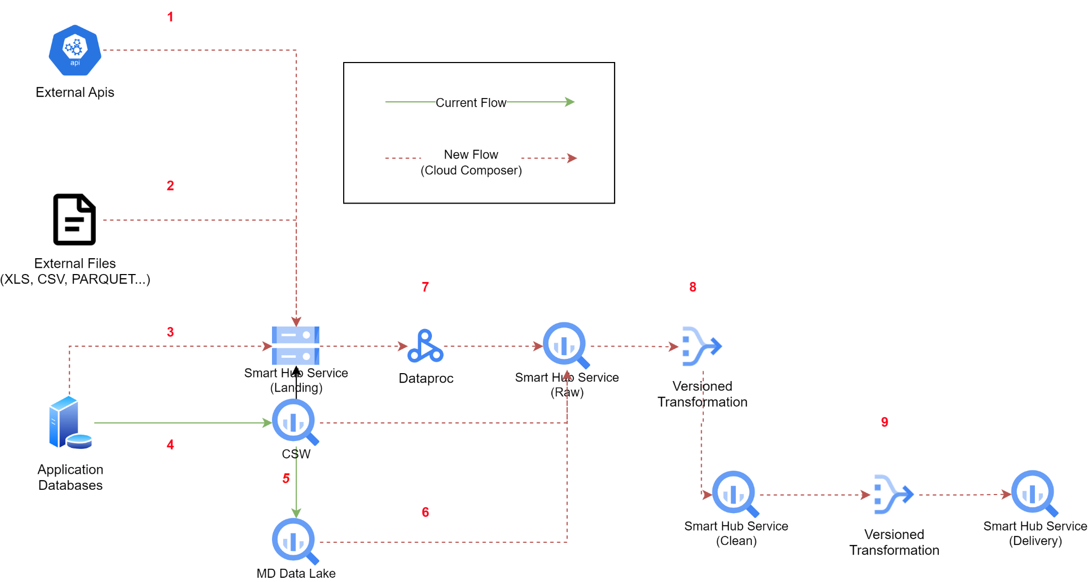

Step by Step
STEPS
1 | External Apis are ingested by Cloud Composer into the raw layer (cloud storage)
2 | External files are ingested by Cloud composer into the Raw Layer (cloud storage)
3 | External Database tables are ingested by Cloud composer into the Raw Layer (cloud storage)
4 | Current applications data is being replicated to CSW (Big Query)
5 | Data from CSW is currently being replicated to MD Data Lake
6 | Data from CSW and MD Data Lake are ingested on the raw layer
7 | Data from Landing Layer is processed into the raw layer by dataproc
8 | Data from the raw layer is promoted to the clean layer using Big Query with rules stored on Dataform
* | All versioned transformations are stored in GitHub
Subheadline

Slide 3
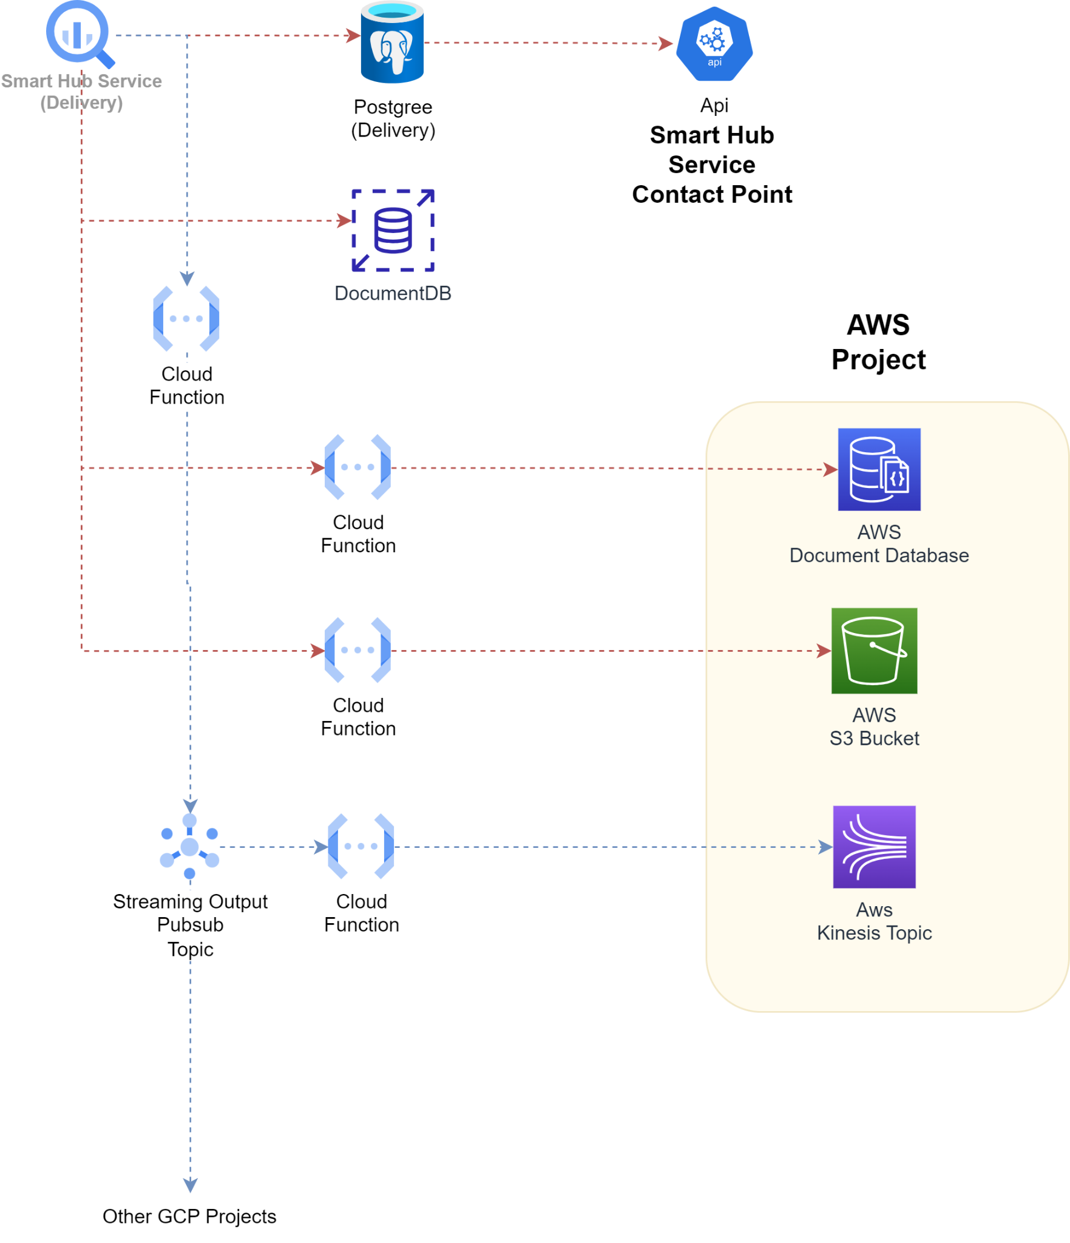



Delivery layer and Integrations
Delivery layer
AWS Integration
Batch data: we can schedule an airflow job to either insert on the Document Database (MongoDB) or put the data in parquet format inside an S3 bucket.
Streaming data: we will provide a pub-sub topic and a cloud function attached to it to produce messages for AWS Kinesis
Batch
Streaming

Slide 4
Why we choose GCP
Main objective for choosing GCP as our cloud provider:
Data source already hosted on GCP avoid complexity on access, inbound / outbound costs, and avoids data transfer issues between clouds and its risks .
Bayer's Brazil teams already have knowledge using GCP services (BigQuery and Apache Airflow) for data transformation and scheduling processes.
The smaller learning curve to maintain the solution compared to choosing another cloud provider.
Easier integration with Google services (no VPC needed, all integration is made using a service account).
Improved productivity and faster results on an architecture that is ready to start implementation.
Bigquery has a seamless integration with another clouds

Slide 5
1 - External Apis are ingested by Cloud Composer into the raw layer (cloud storage)
2 - External files are ingested by Cloud composer into the Raw Layer (cloud storage)
3 - External Database tables are ingested by Cloud composer into the Raw Layer (cloud storage)
4- Current applications data is being replicated to CSW (Big Query)
5- Data from CSW is currently being replicated to MD Data Lake
6- Data from CSW and MD Data Lake are ingested on the raw layer
7- Data from Landing Layer is processed into the raw layer by dataproc
8- Data from the raw layer is promoted to the clean layer using Big Query with rules stored on Dataform
9- Data from the clean layer is promoted to the delivery layer using Big Query with rules stored on Dataform
* (All versioned transformations are stored in GitHub)
Steps

Slide 6
Delivery layer and Integrations
AWS Integration
For batch data, we can schedule an airflow job to either insert on the Document Database (MongoDB) or put the data in parquet format inside an S3 bucket.
For streaming data, we will provide a pub-sub topic and a cloud function attached to it to produce messages for AWS Kinesis
Batch
Streaming

